Slide 1
Hi Lin,
Here are some of the changes to Matthew Can
Music: & Sound: 1.1 for introduction, 1.2 for bonus points at 100, 200,300, 400, 500; 1.3 for missing the bonus points, 1.4 for bonus points at last correct entry of a time table to
accompany the Reward clips (to replace the short clips at
every correct answer ) 1.5 for errors, 1.6 for scores, 1.7 for
time’s up 1.8 for during game play,
In addition to emailing results to their teachers/parents Capture and send the top scorers - e.g. >10,000 20,000 (let me be able to change this score later as the high scores get ever bigger.)
Make sure that every user’s email address is captured at the start of the game. Loop back if they don’t Sign up.
More details for changes follow…

Slide 2


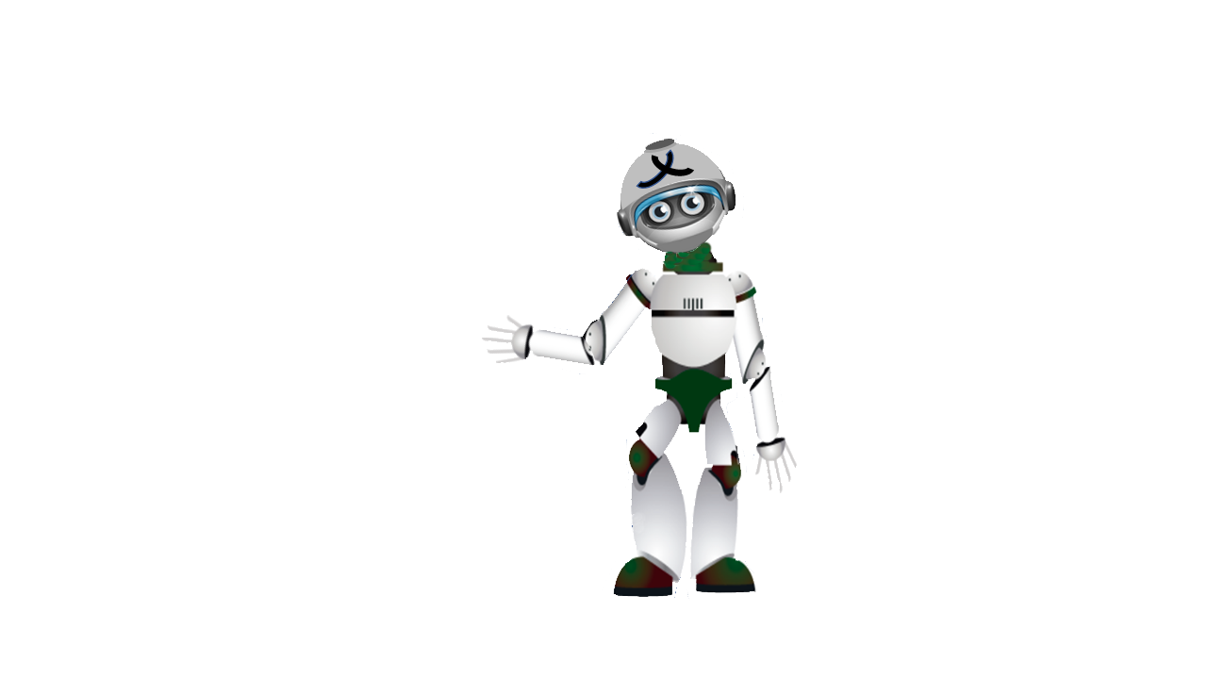
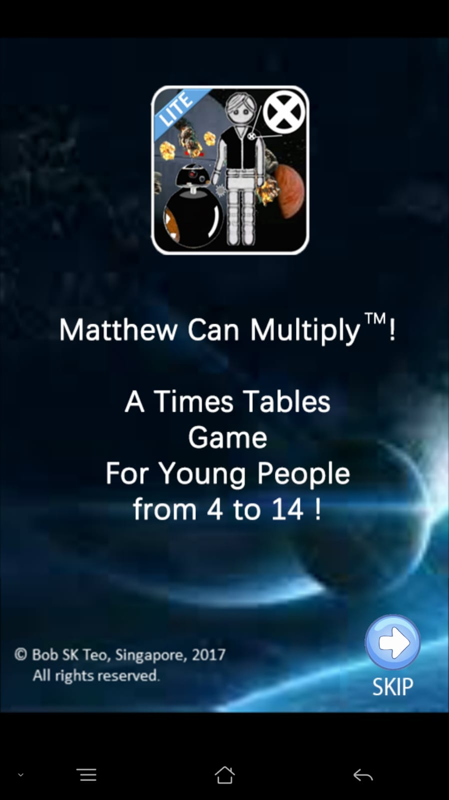
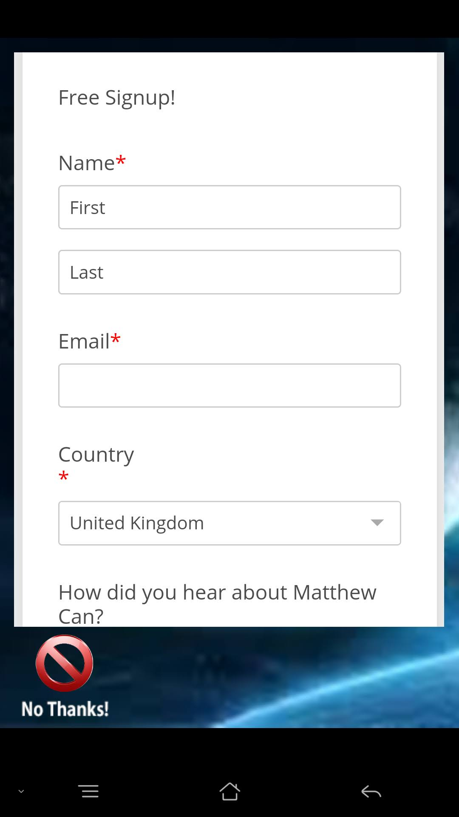


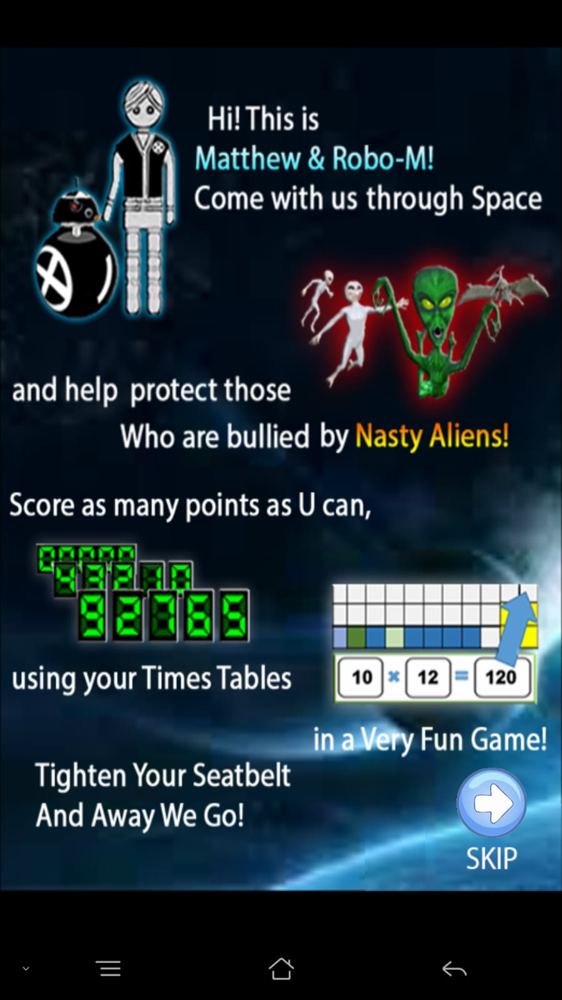
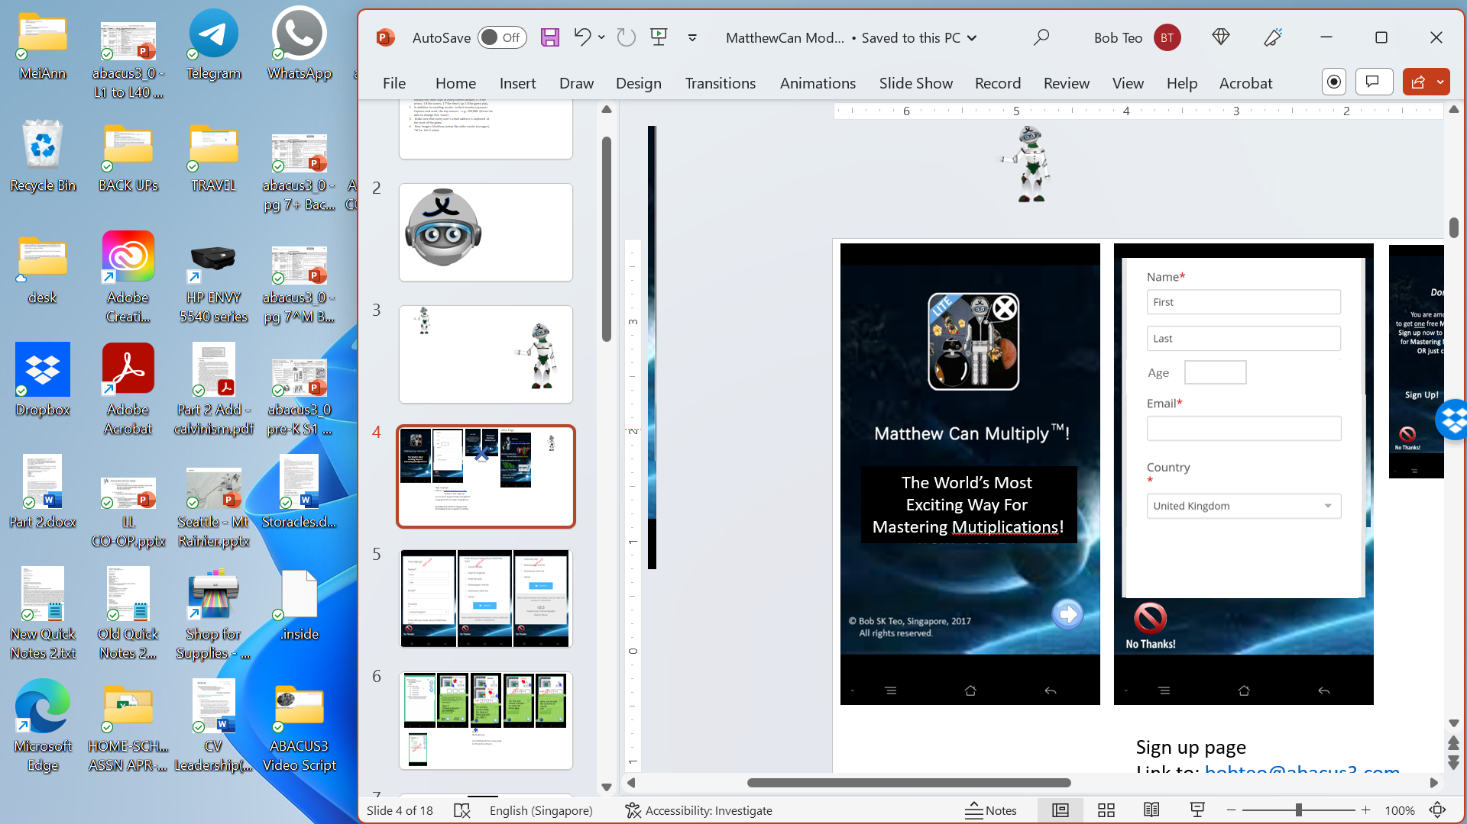
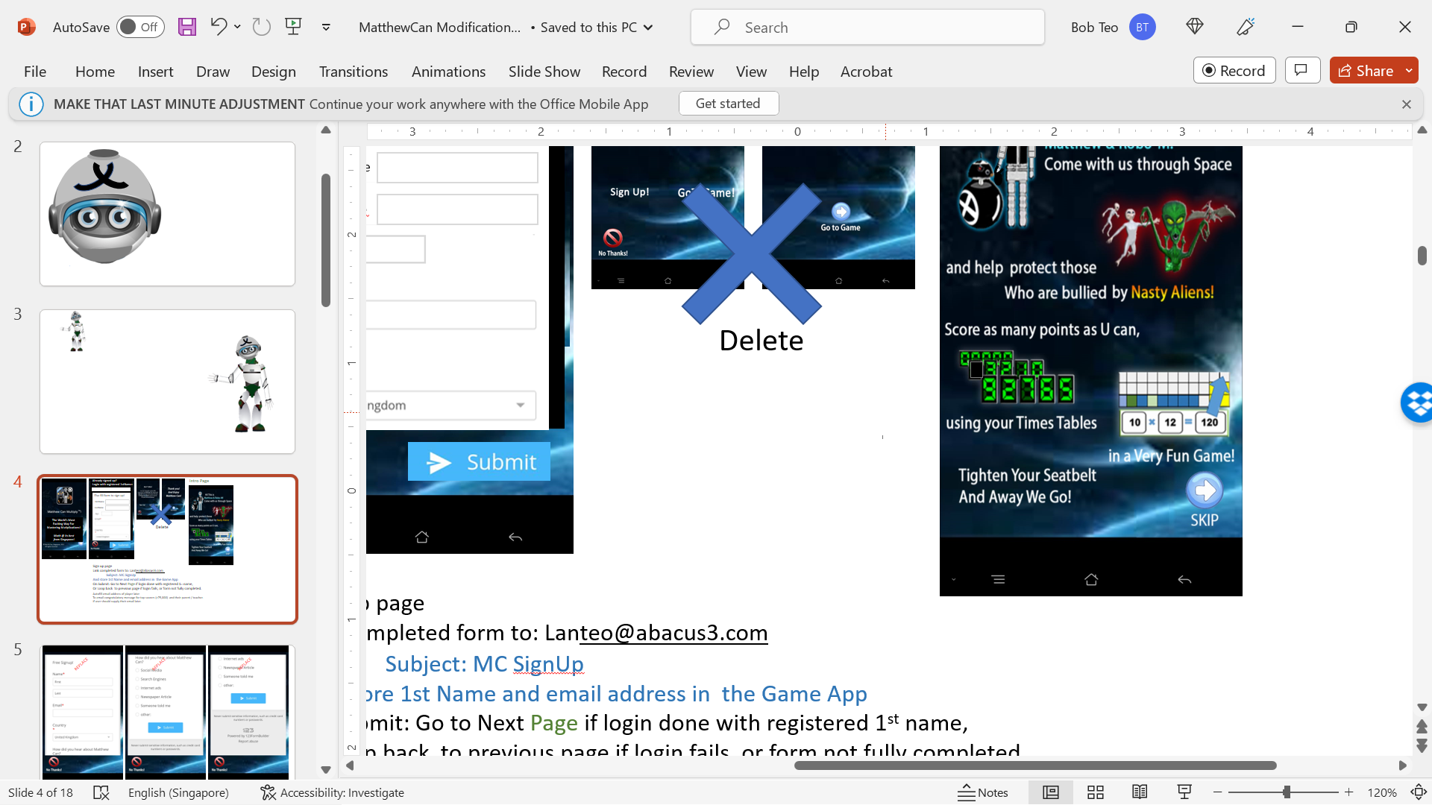
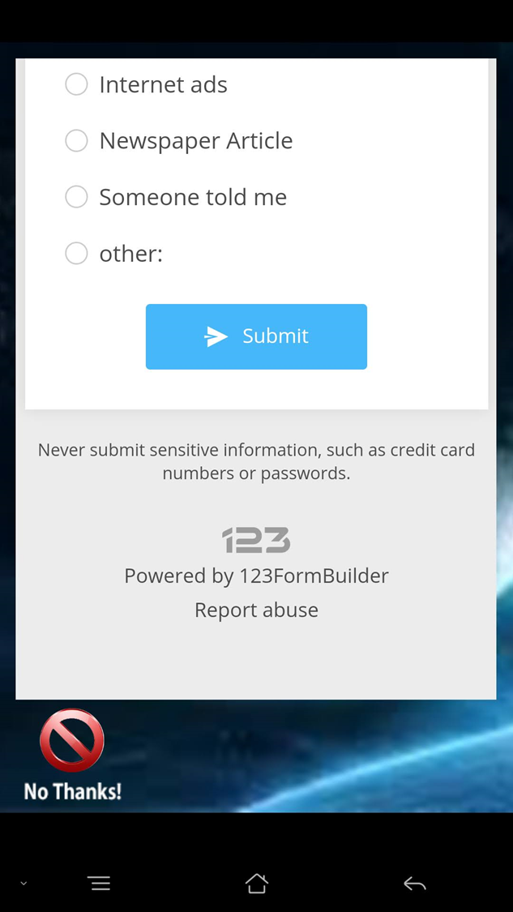
Congratulations!
Already signed up?
Login with registered 1stName:
Intro Page
Welcome to our world !
Sign up now to get the game,
and tips and tools for Mastering
The Times Tables!
Else fill form to sign up!
Age
M
F
FirstName
Sign up!
LastName
Already signed up?
GoToGame!
The World’s Most
Exciting Way For
Mastering Mutiplications!
Math @ its best
from Singapore!
Delete
Get Game Free!
Replace this introduction
sequence with:
Sign up page
Link completed form to: Lanteo@abacus3.com
Subject: MC SignUp
And store 1st Name and email address in the Game App
On Submit: Go to Next Page if login done with registered 1st name,
Or Loop back to previous page if login fails, or form not fully completed.
https://starwarsintrogenerator.com/scroller?u=2hh97yk3
Autofill email address of player later
To email congratulatory message for top scorers (>10,000) and their parent / teacher.
if user should supply their email.

Slide 3
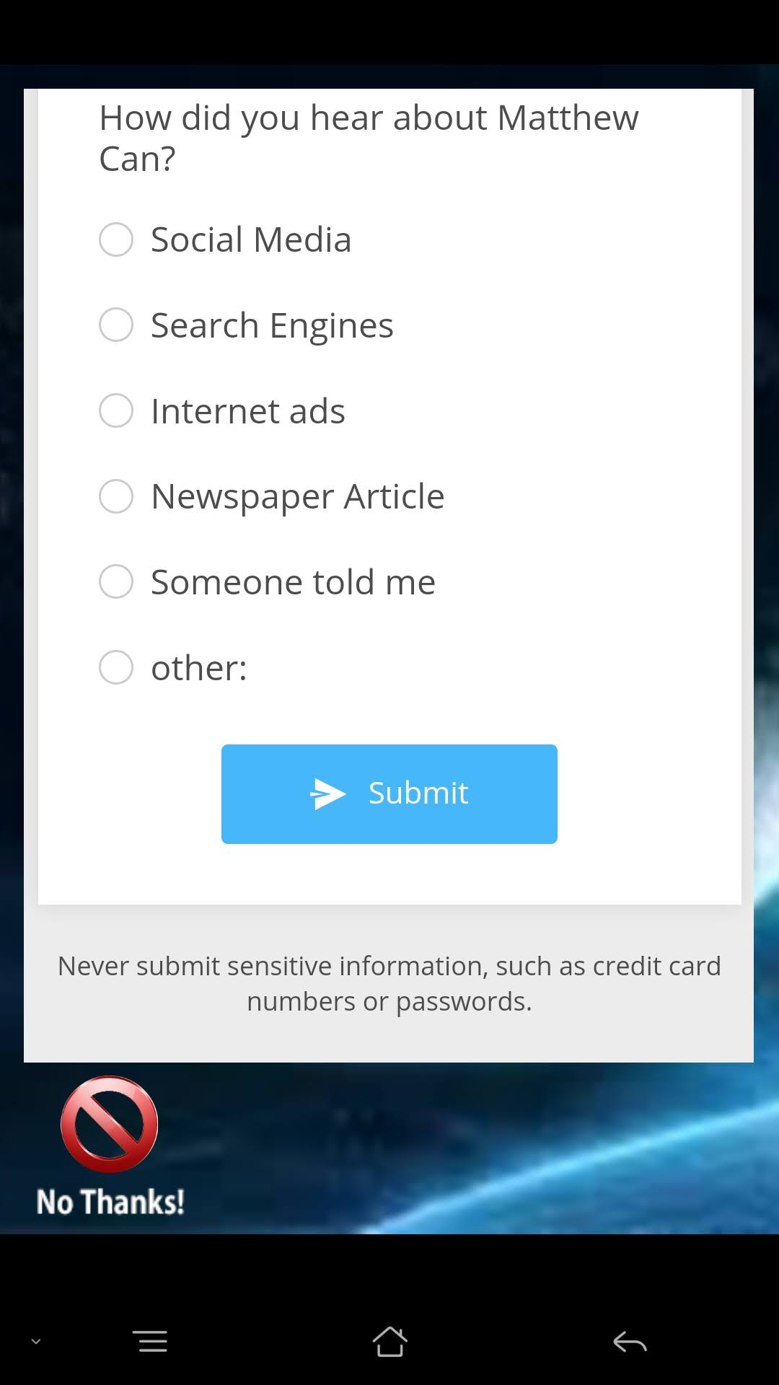

REPLACE
REPLACE
REPLACE

Slide 4
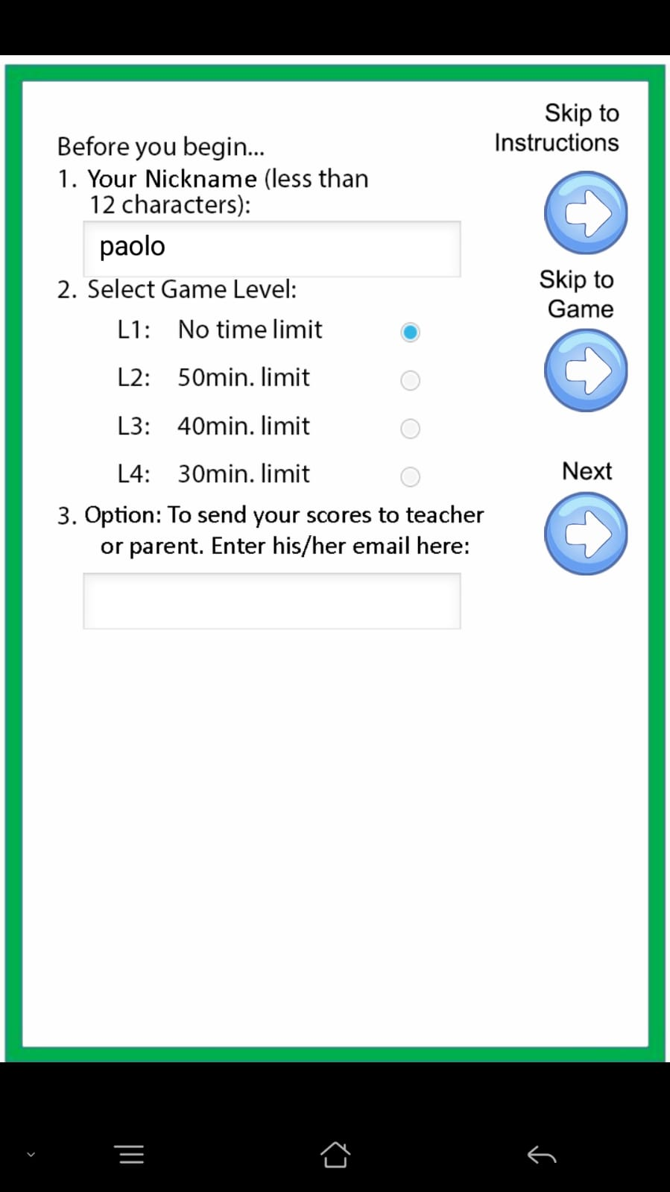
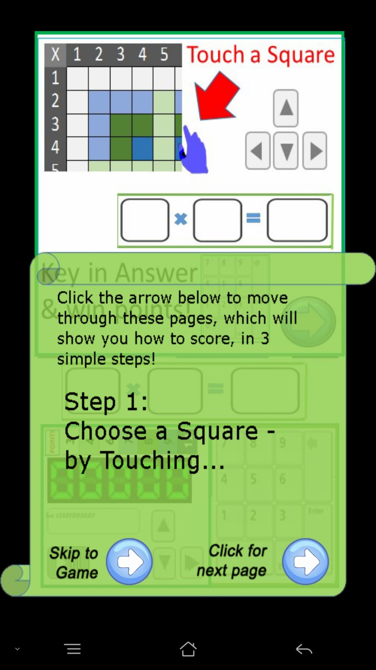
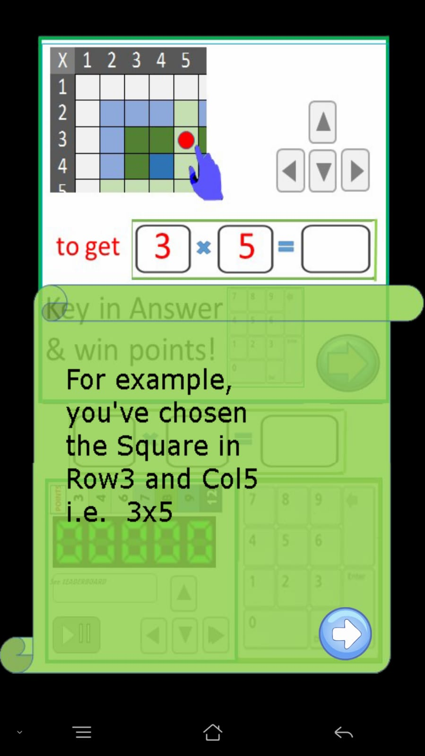
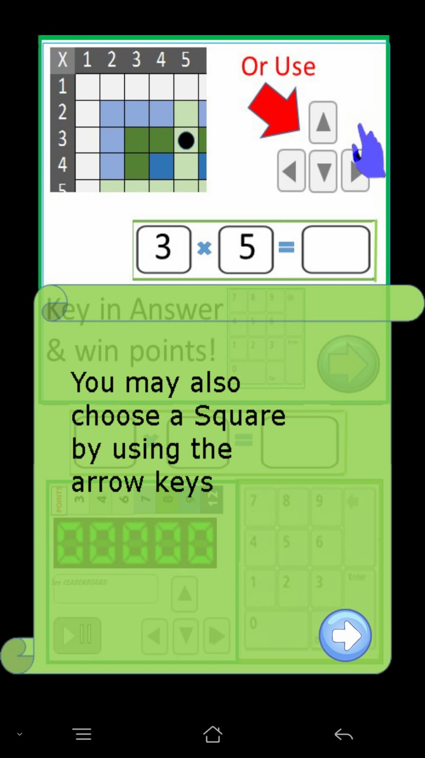
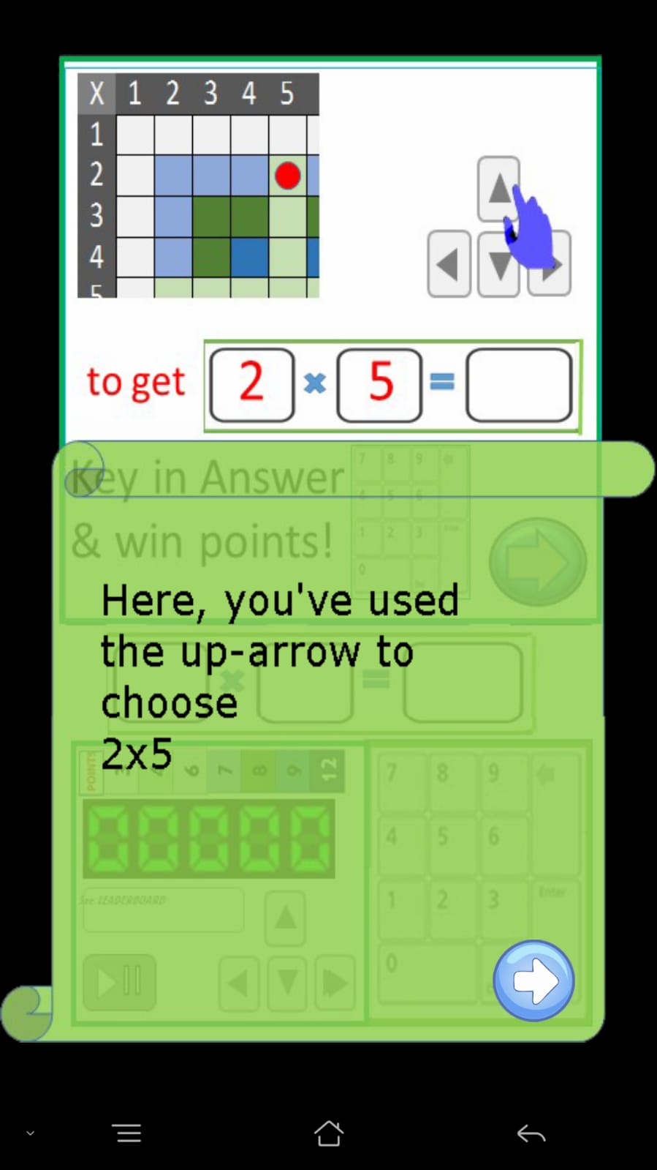
Touch..
DELETE
DELETE
Insert
Back Arrows
(and link back for every page
in the Instructions)

Slide 5
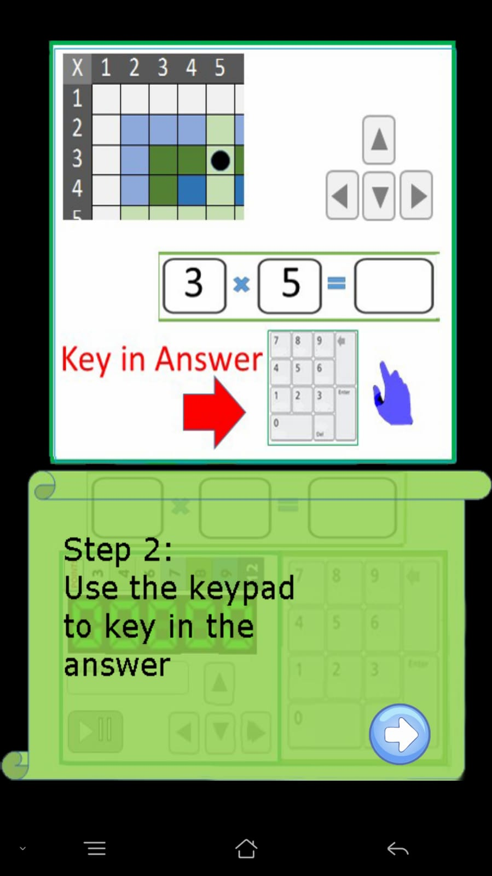
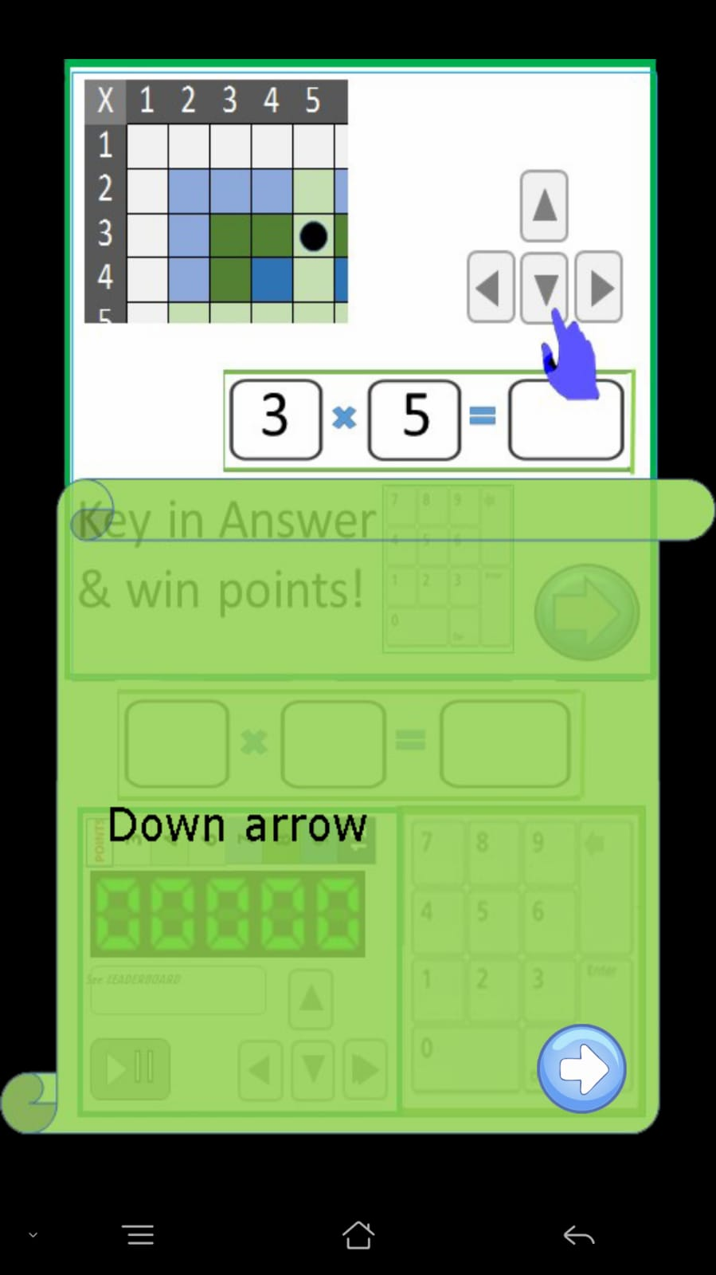
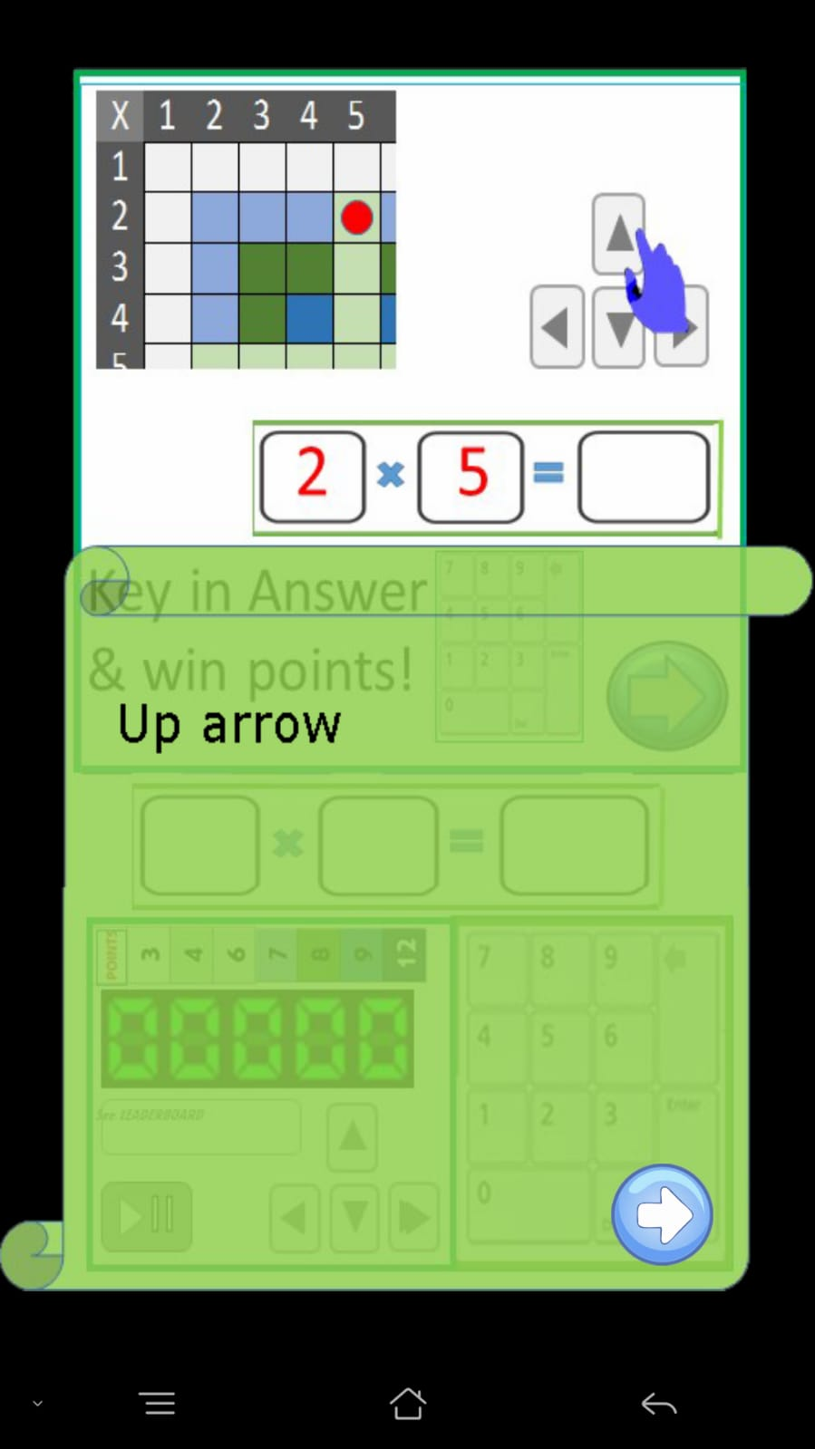
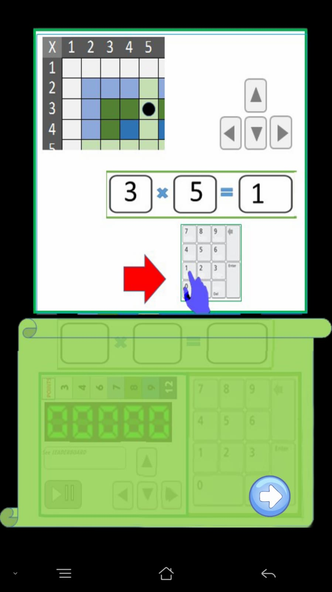
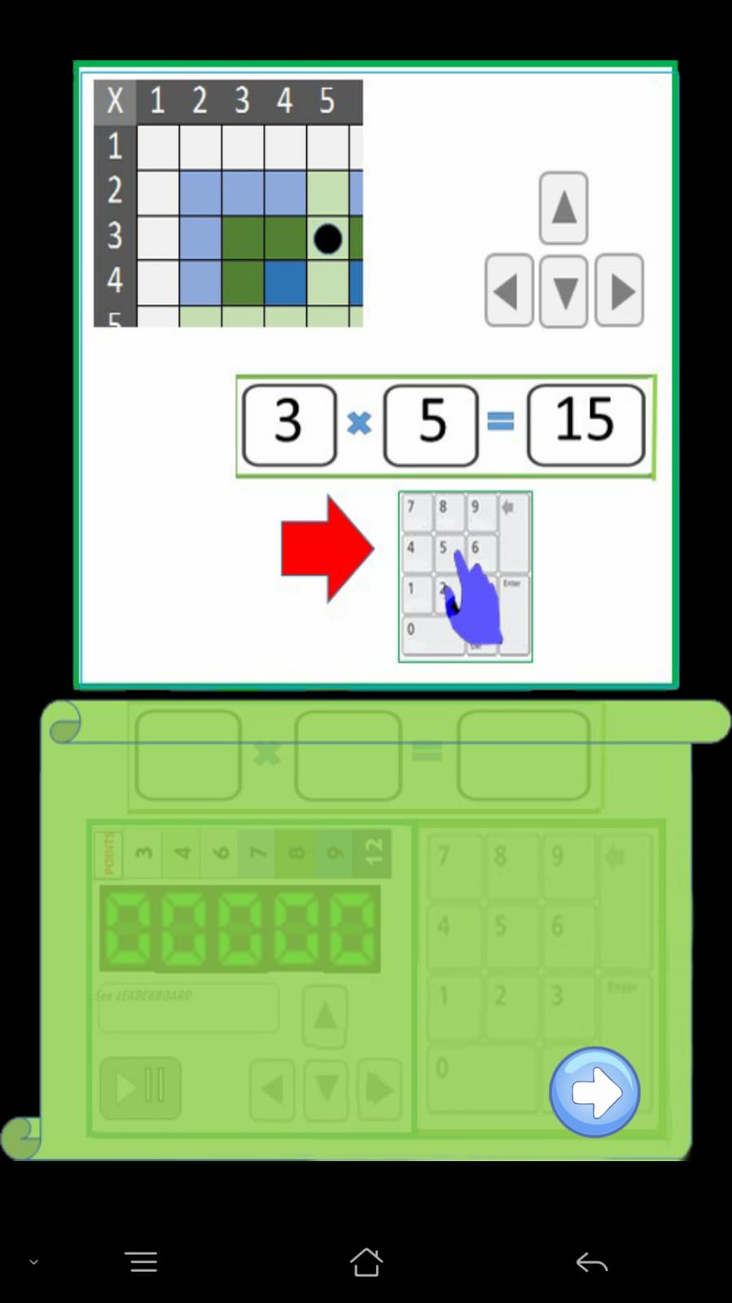
DELETE
DELETE
DELETE
DELETE

Slide 6
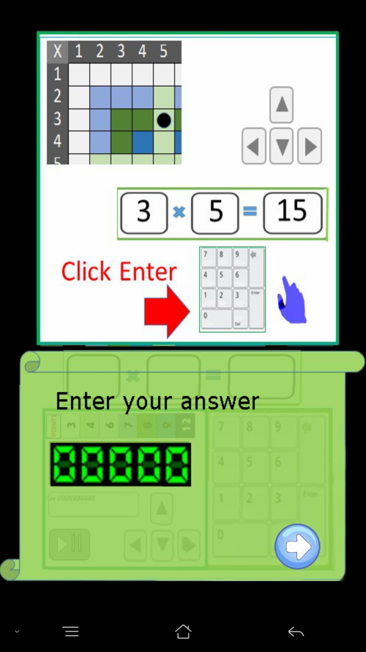
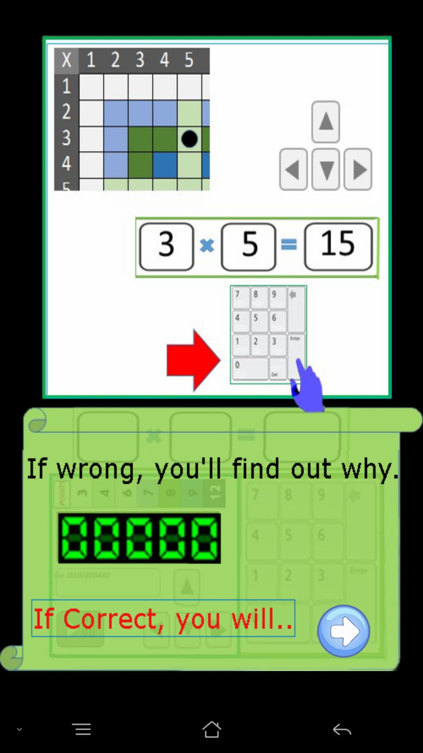
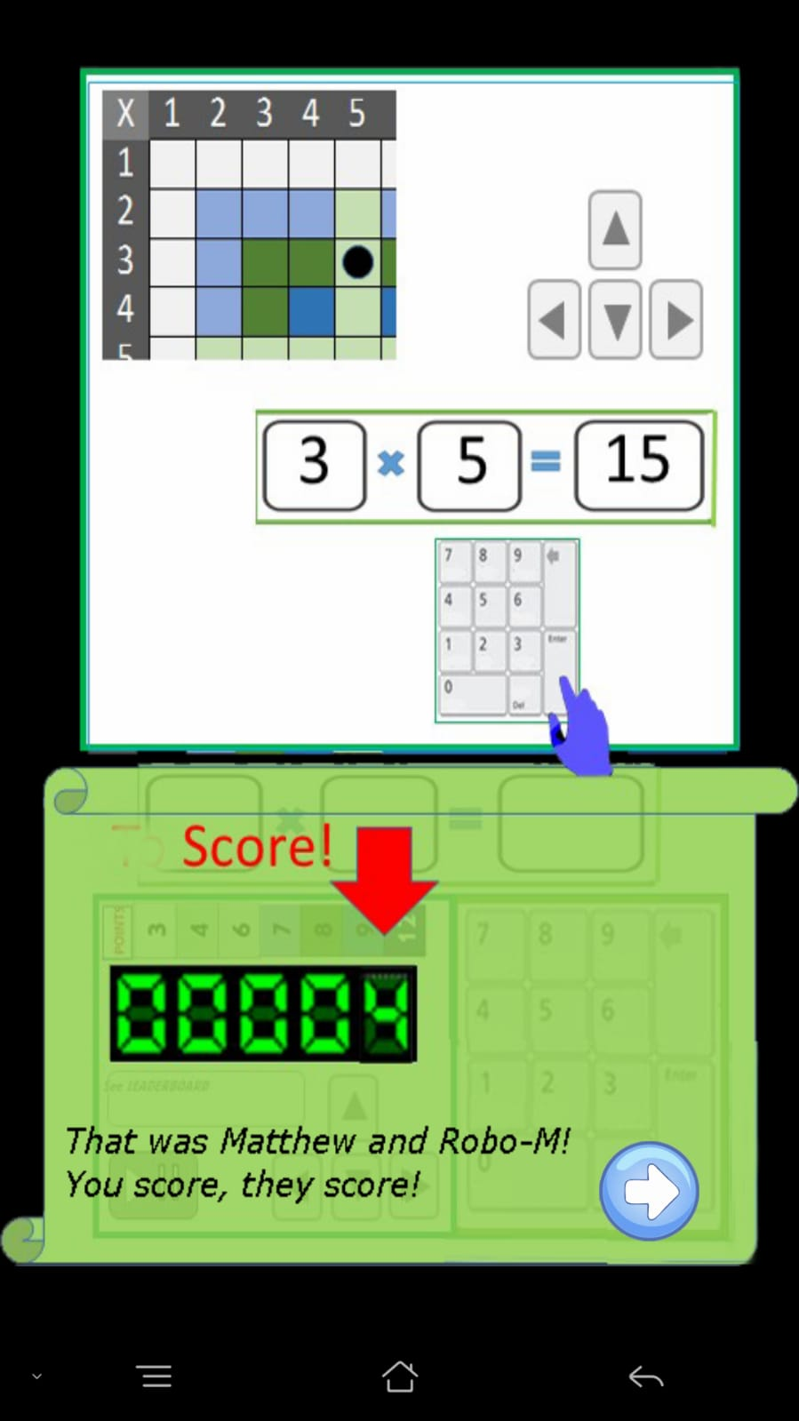
+4
That’s Matthew and Robo-M!
When you score,They score!
[There’s a sound file here:
“Well done Robo- …”
Keep it here till I send you
an updated version]

Slide 7
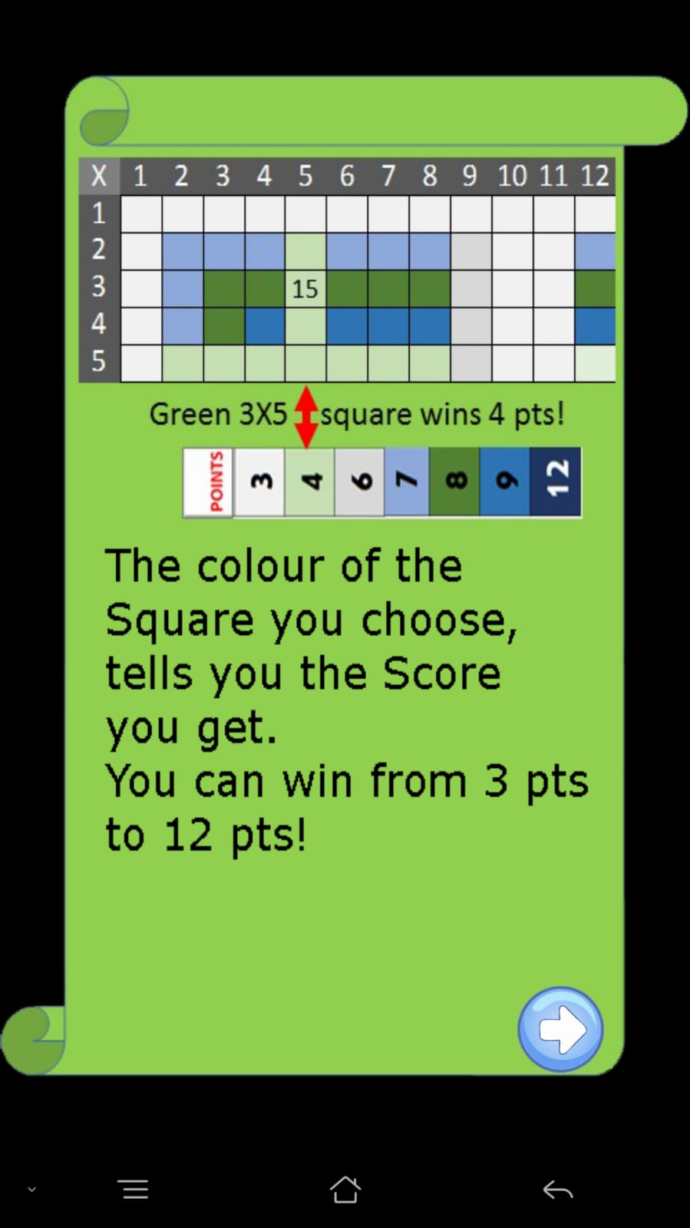
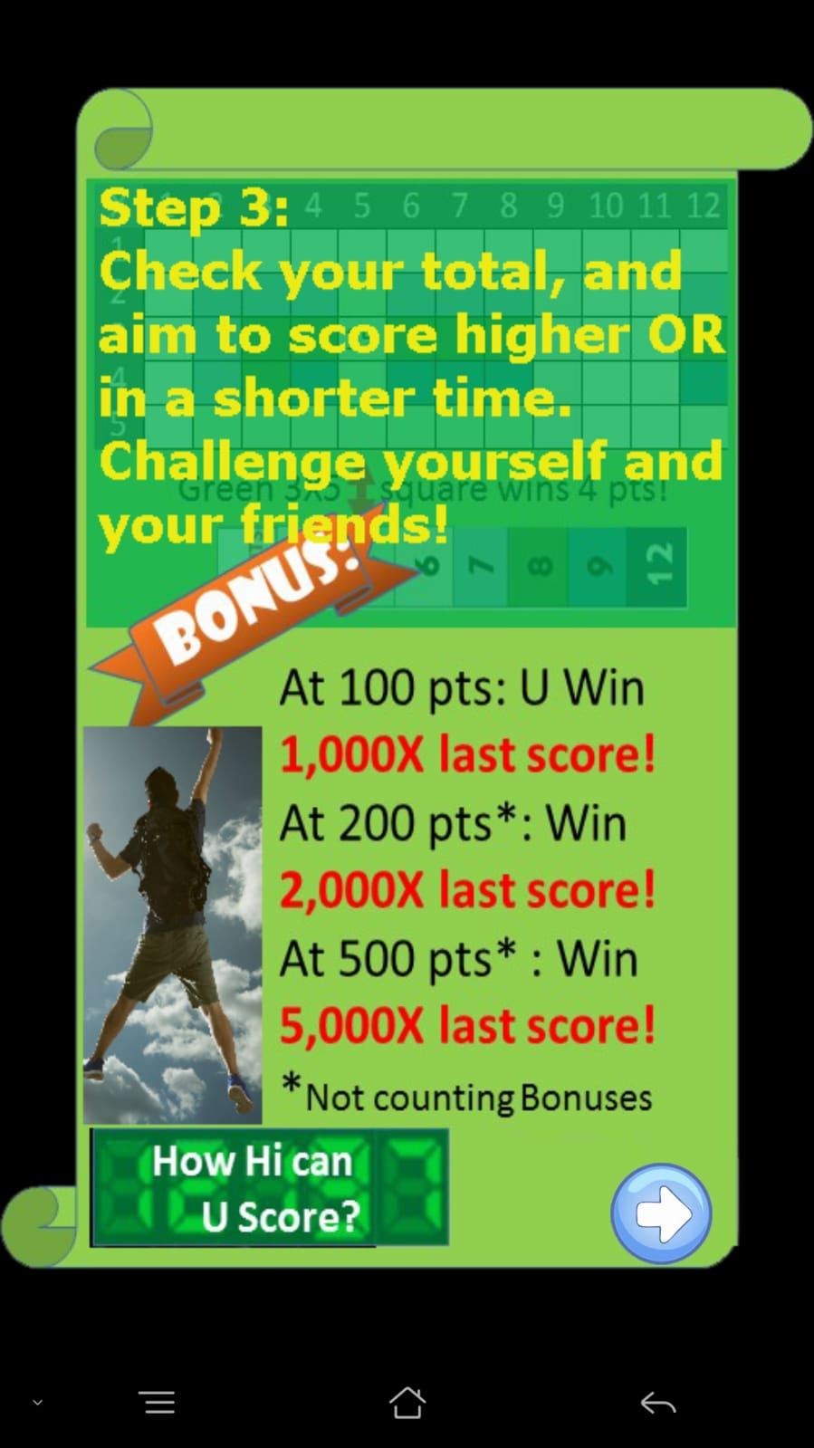
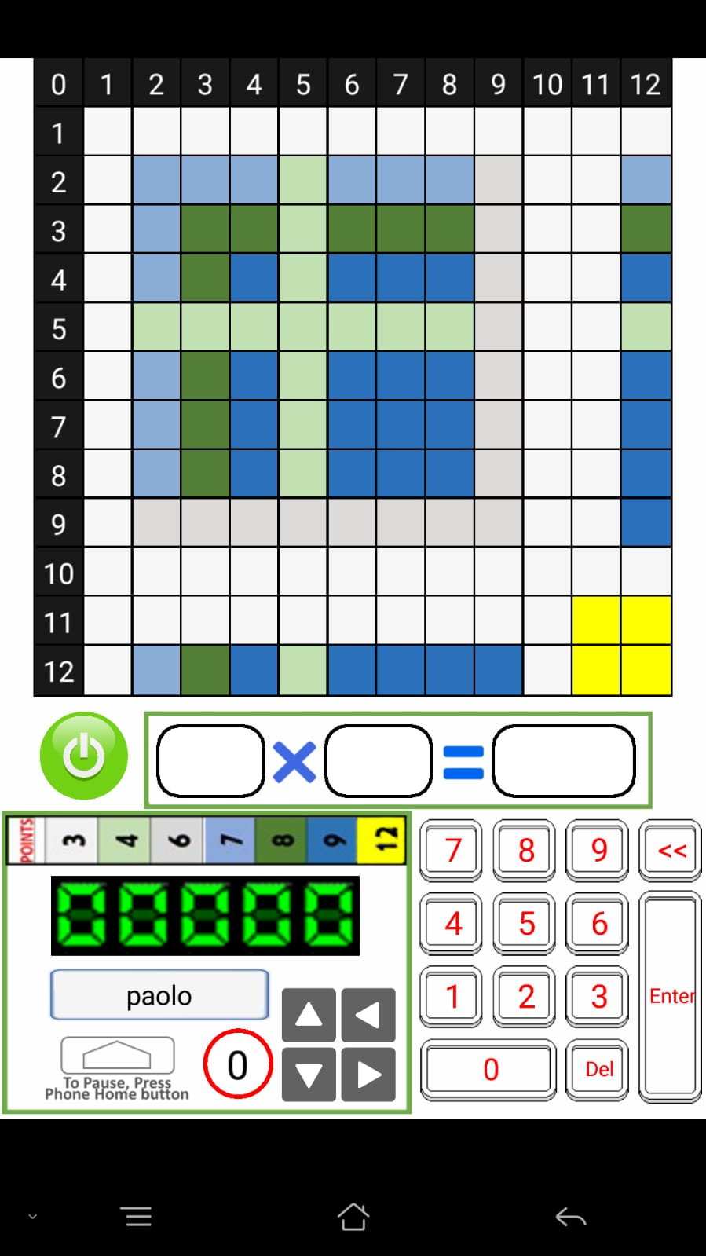
Scoring High!
Tap on a Square to Start
Type answer & Enter
IF the Player enters a wrong answer,
show appropriate Tip page.
Resume game music and clock
when Player Clicks CONTINUE
at the Tip page.
IF the Player enters a correct answer…
Show flashing Score in the score
board, while Rapidly increasing the
Counter below the score board to
the new total.
Show Reward page when appropriate
i.e. player just completed a line
(row or column) representing all 12
Items in a time-table. This changes
the function in the previous version
which rewarded every time Player
scores.
When Reward page is completely
shown, or when Player SKIPS
And then selects/touches a square
Resume music and clock.
At end of game, stop music
and clock.
When your score passes 100 pts.,
You Win 100
times the score!
Pass 200 pts* : 200X
Pass 300 pts* : 300X
Pass 400 pts* : 400X
Pass 500 pts* : 500X
*Not counting bonuses
Jin: The previous version had only
100,200, and 500 pts
Add 300 and 400 pts.
Tap on a Square to Start
Type answer & Enter
Use Flashing Text here –
And make disappear when
Player touch a square.
Display the next page.
If player touches a Square and
Does not type an answer,
Open Flashing Text of message here –
make disappear when Answer has
been typed and Enter has been pressed.
Start music and timing
when a Square has
been touched.
When player type Answer and Enter
STOP music and PAUSE clock., To resume
when Player touch/select another square.

Slide 8
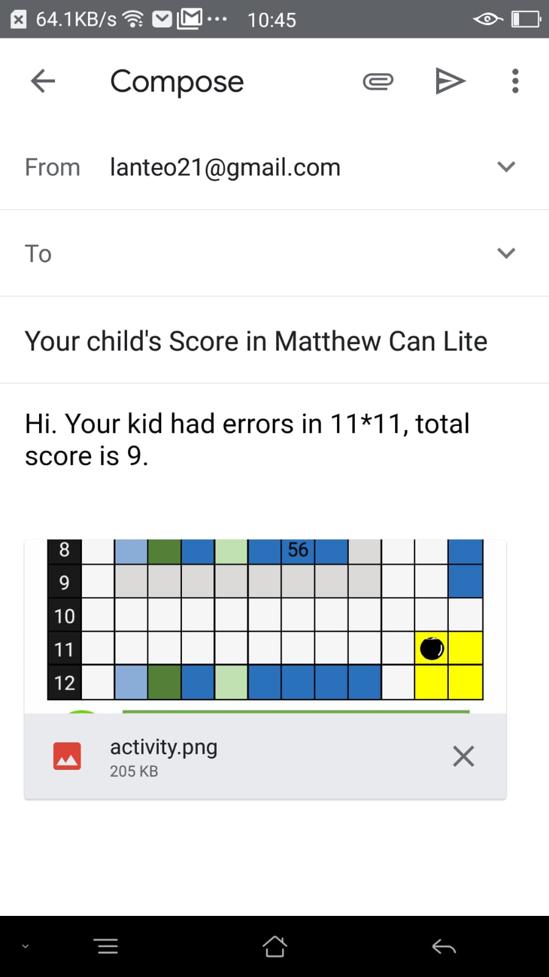
#Autofill email address of player#
#Autofill email address of player#
#Autofill teacher’s email address
#Autofill teacher’s email address
#Firstname’s Score in Matthew Can
YOU HAVE A TOP SCORER!”
Total Score this Game:
Errors:
Total Score this Game:
Errors:
REPLACE
Send this for those
who registered their
Parent’s/teacher’s
email address.
Send this for those
who registered their
Parent’s/teacher’s
email address
AND
when Player scores
= or > than 10,000
20,000

Slide 9
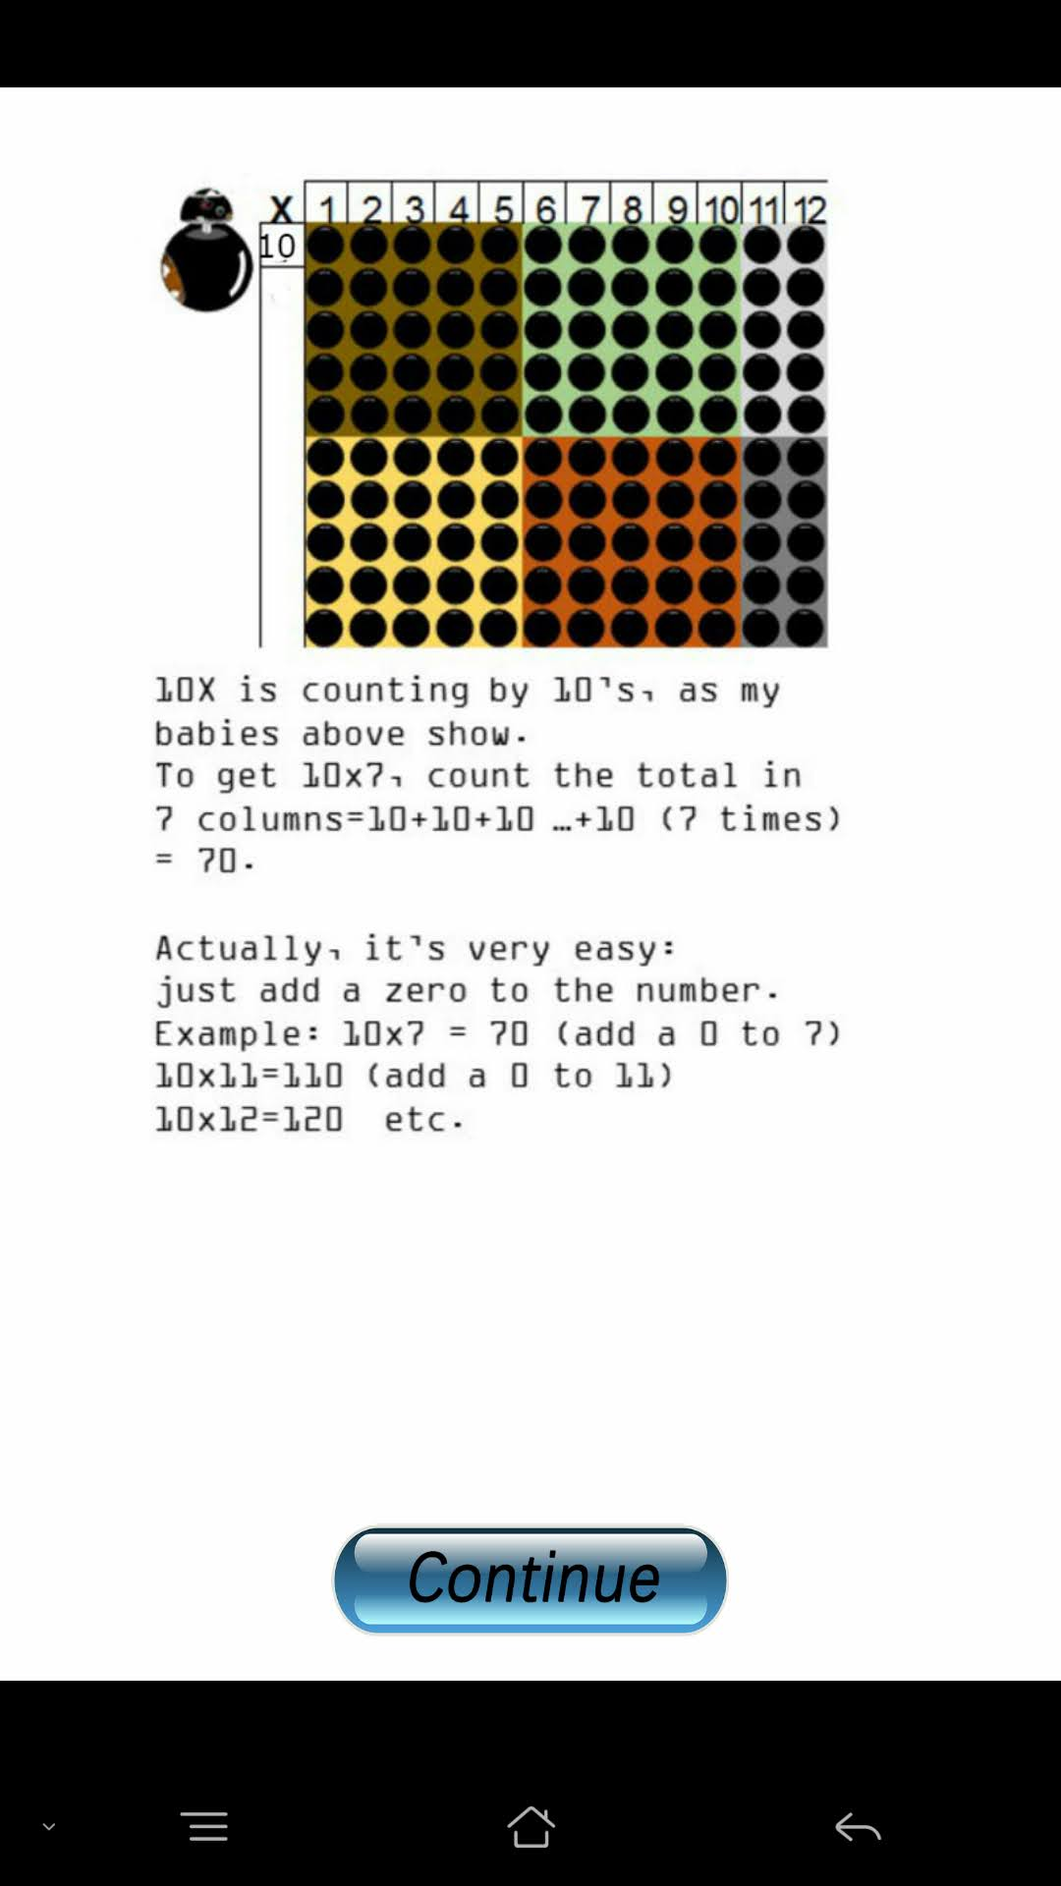
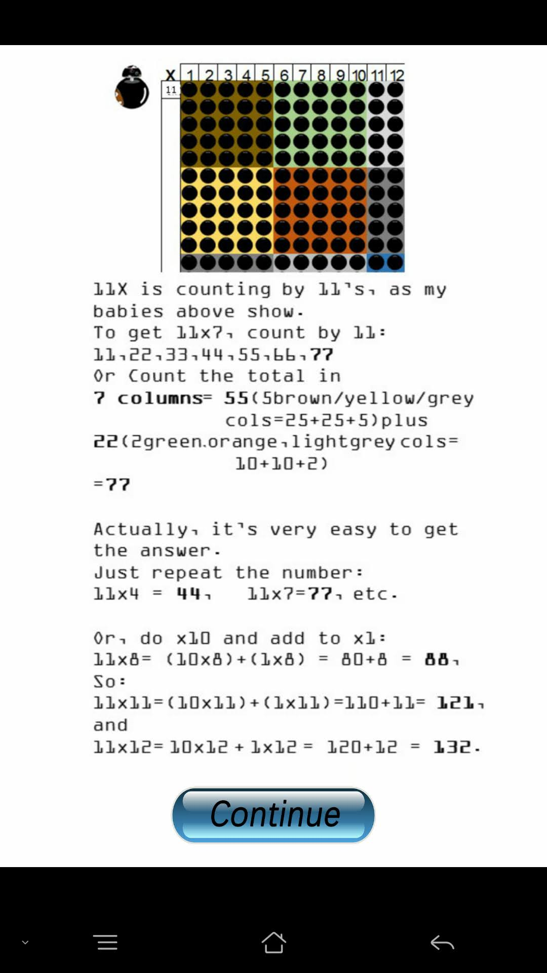
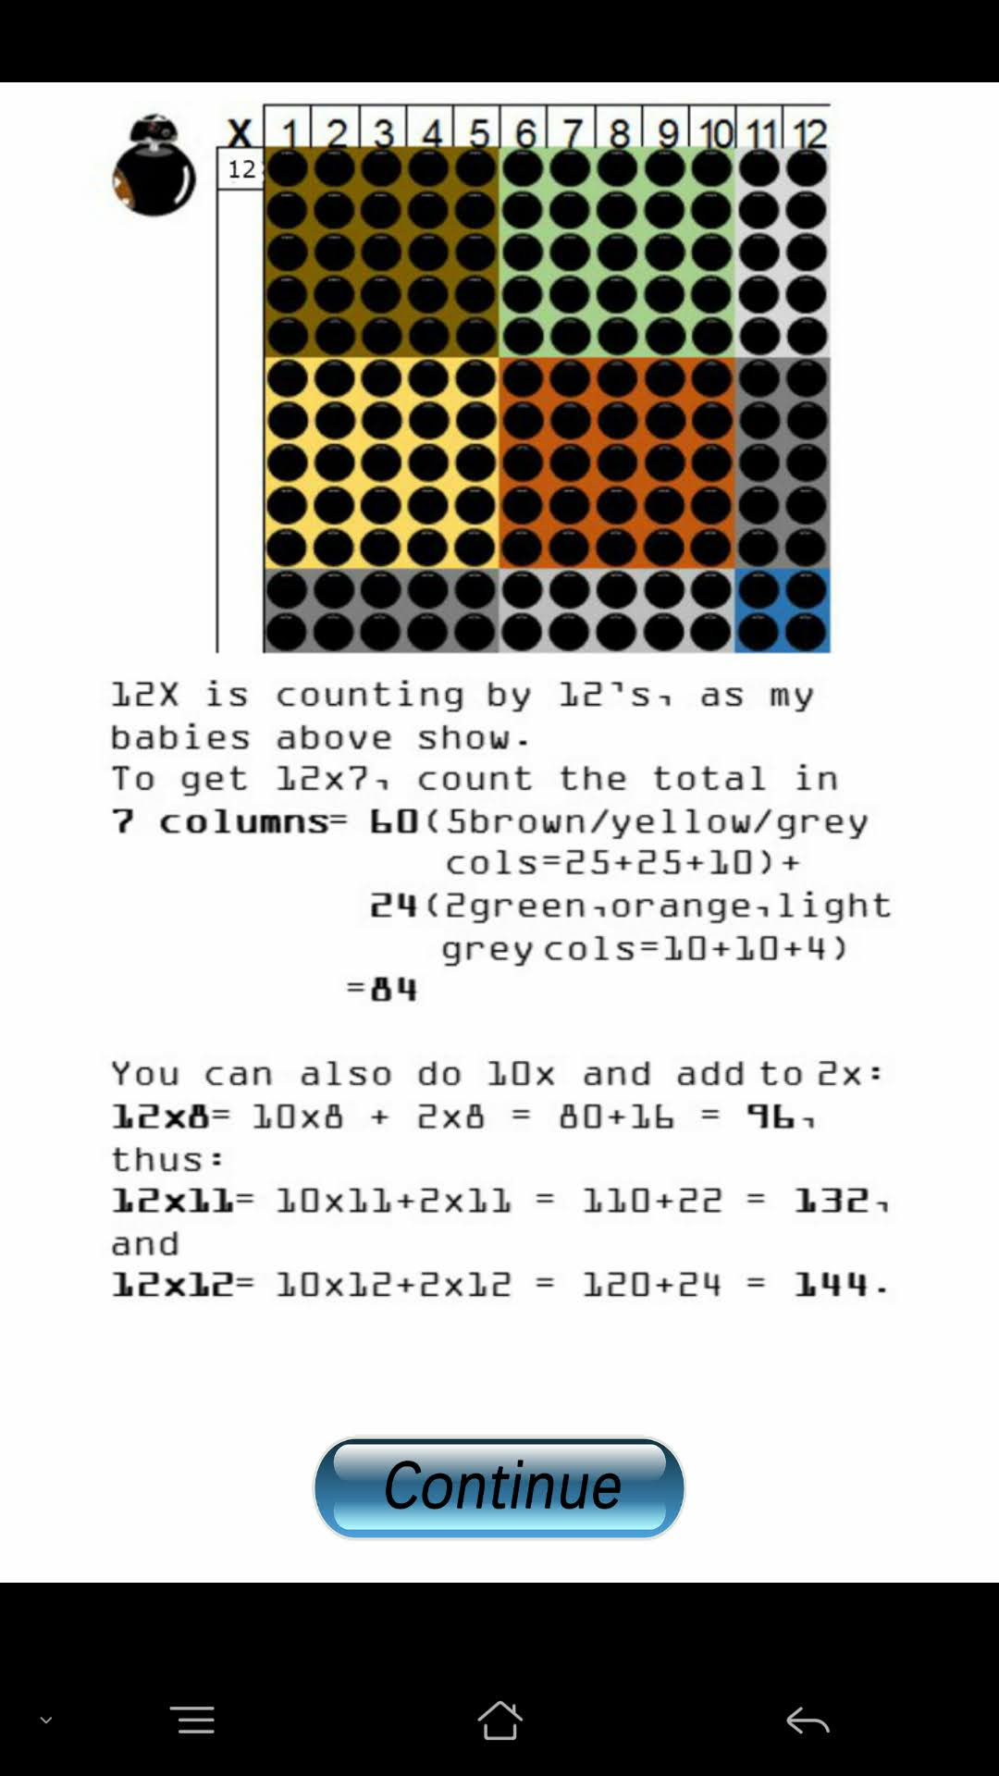

Slide 10
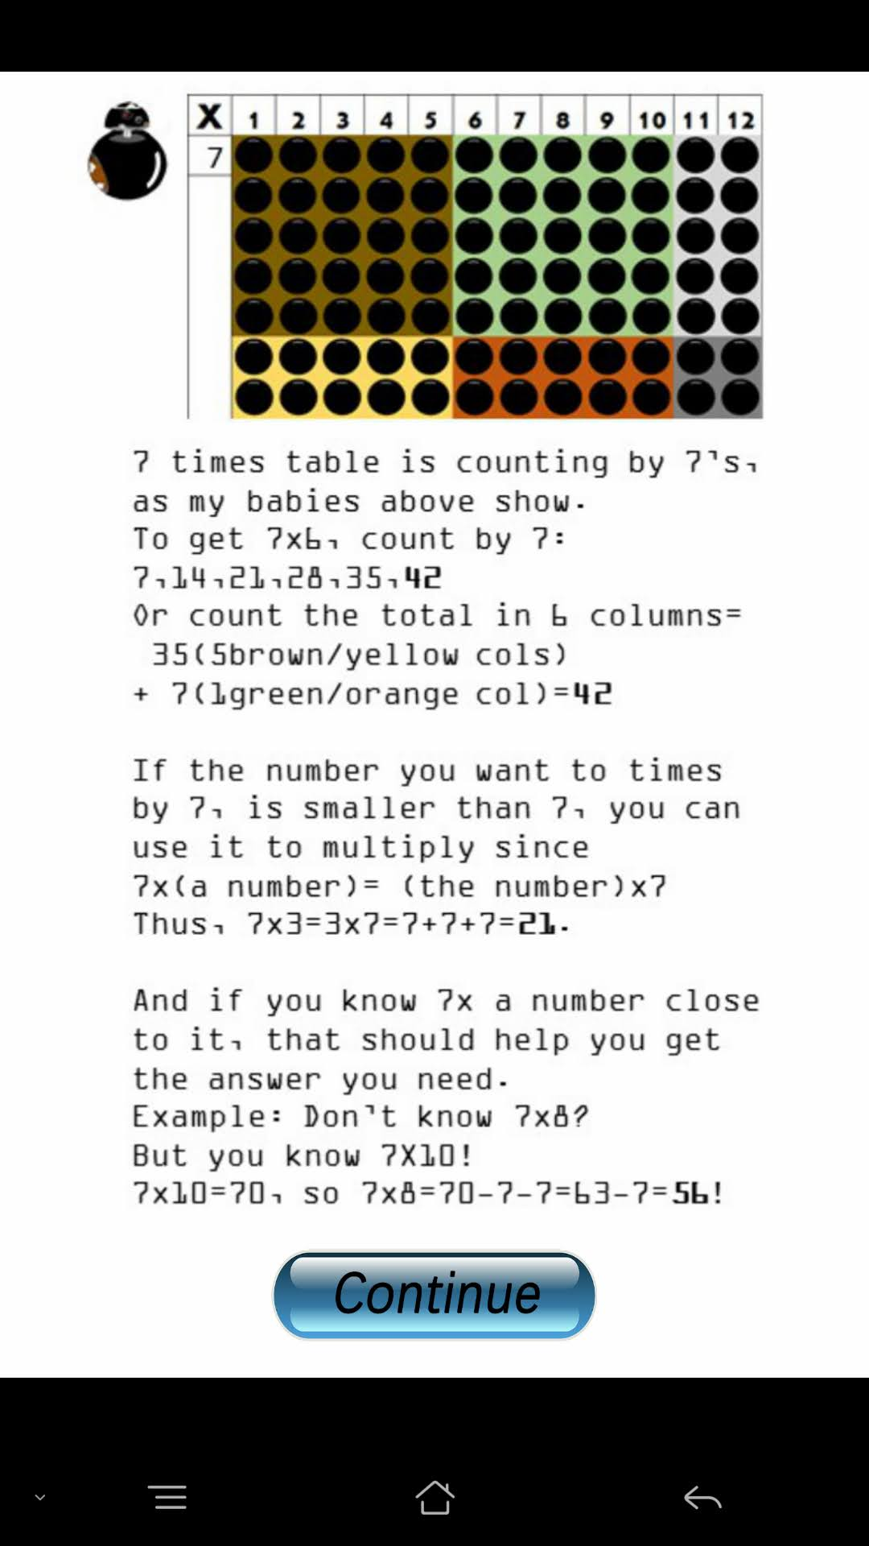
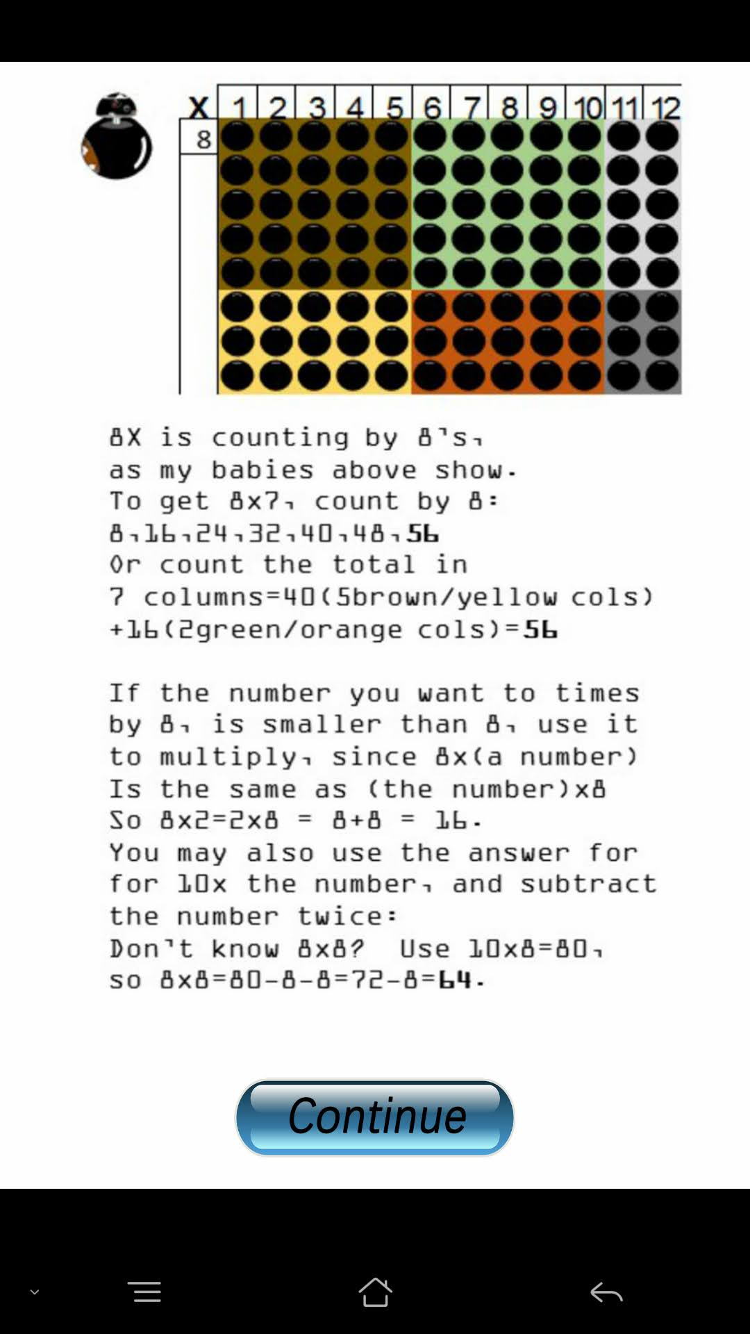
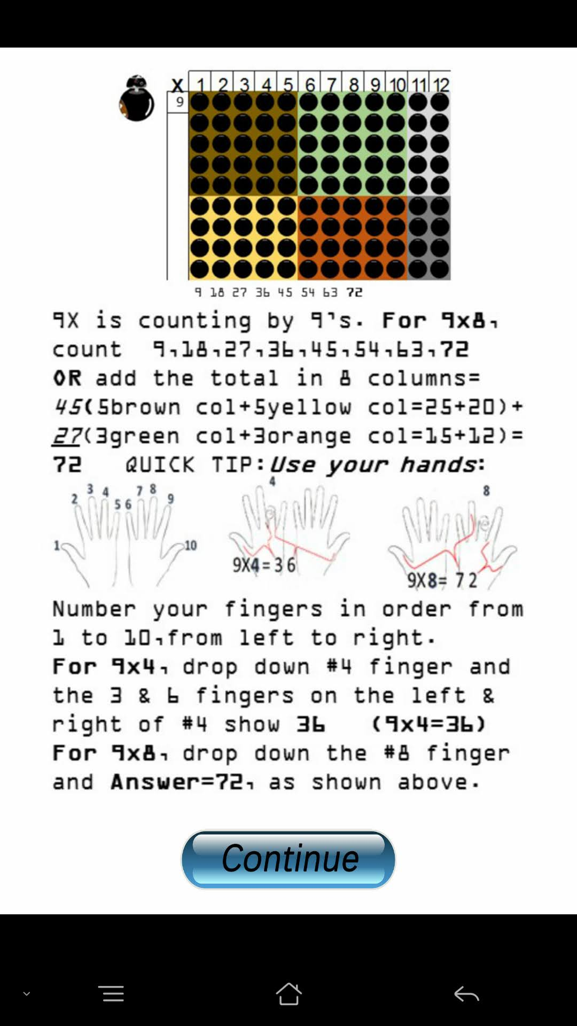

Slide 11
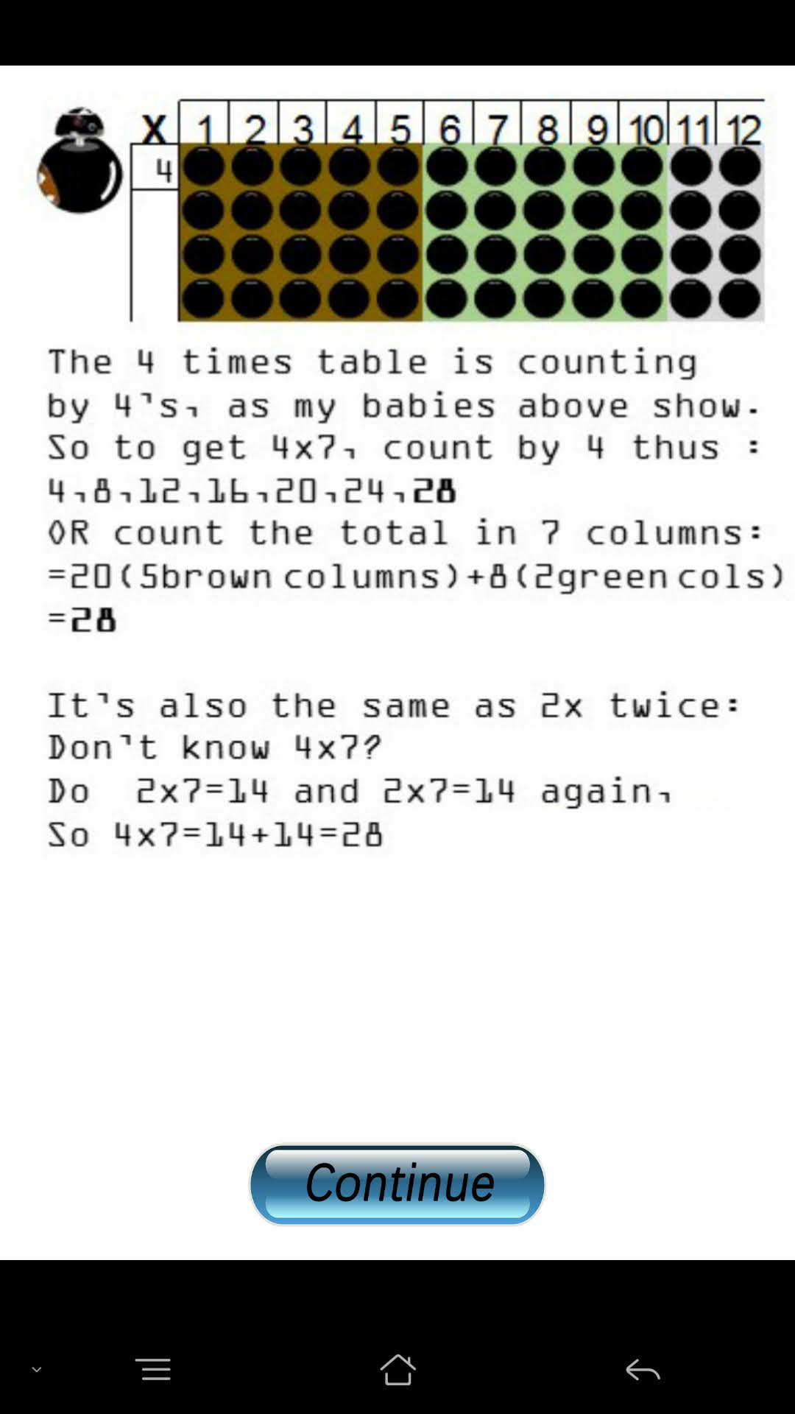
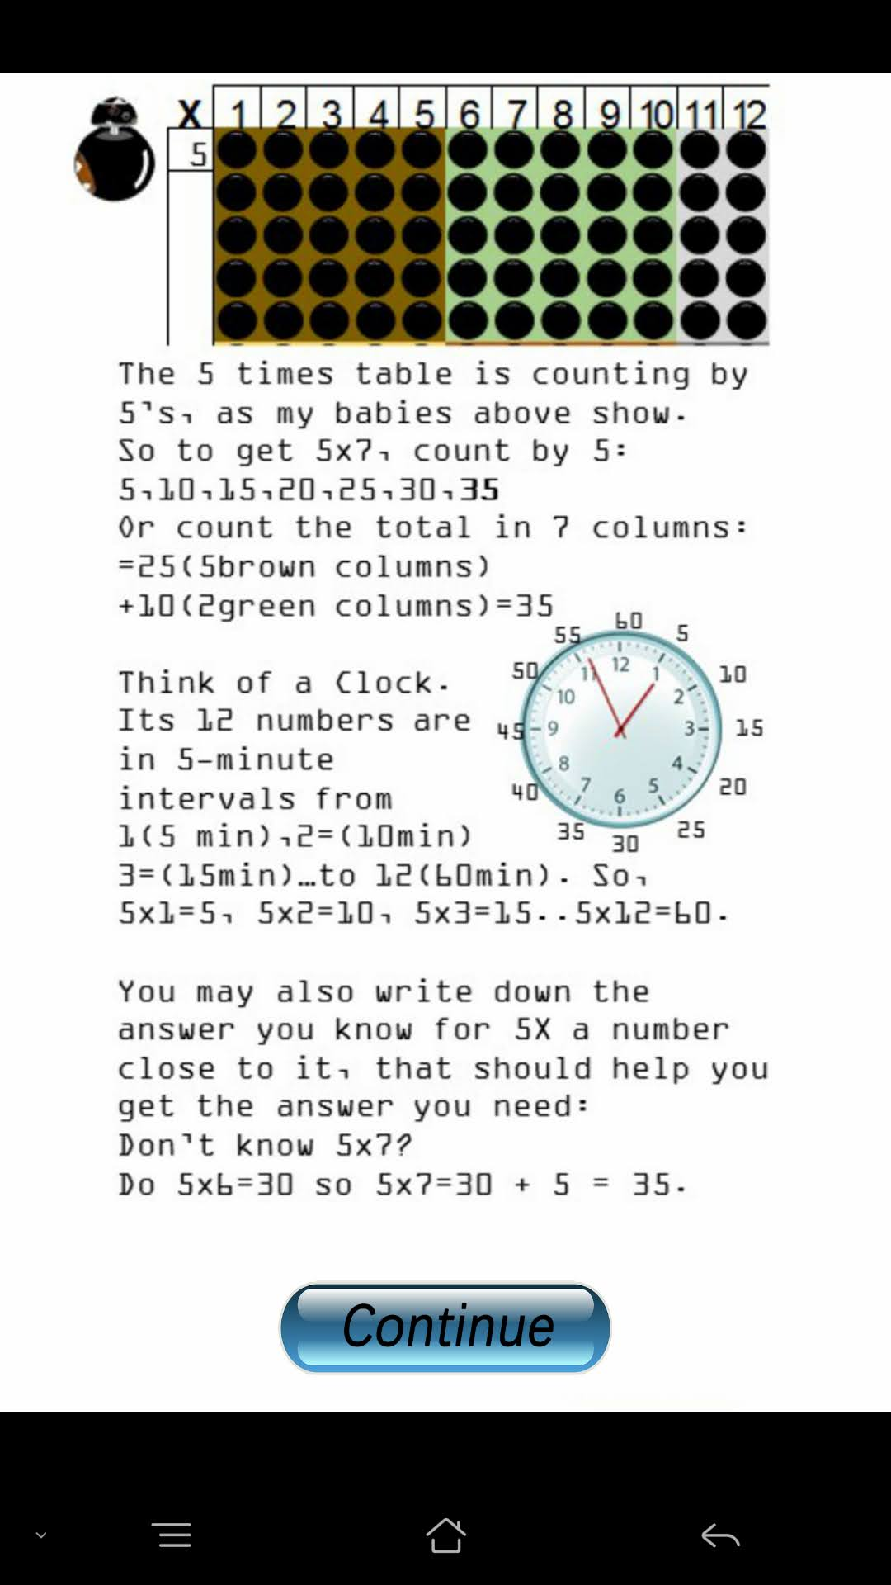
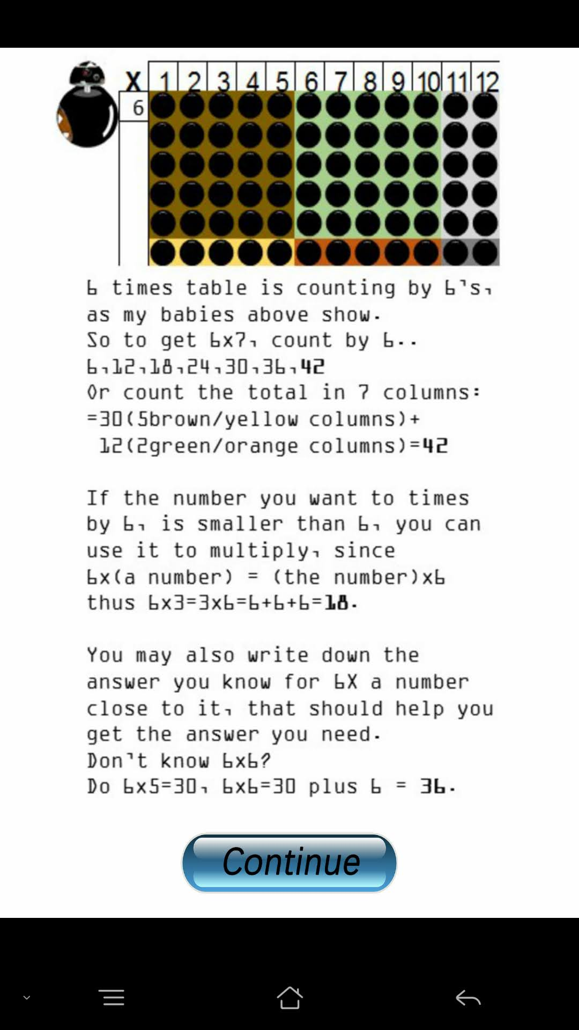

Slide 12
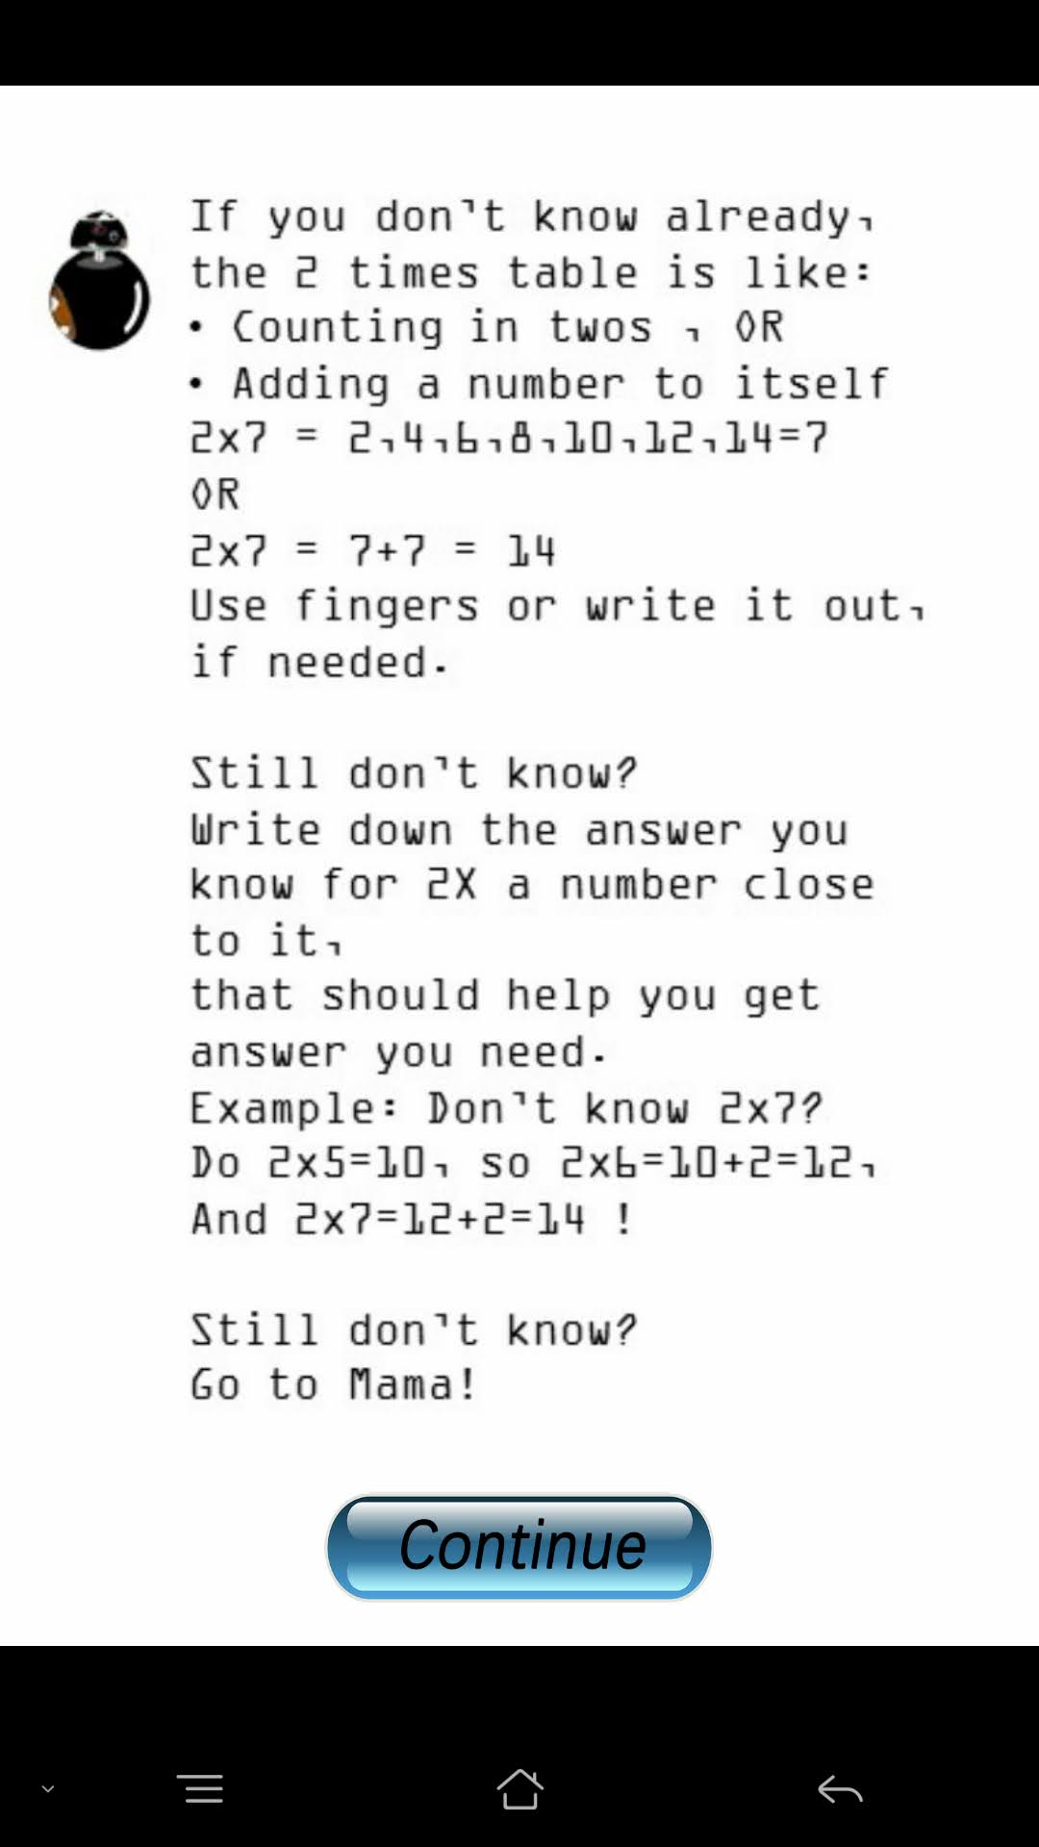
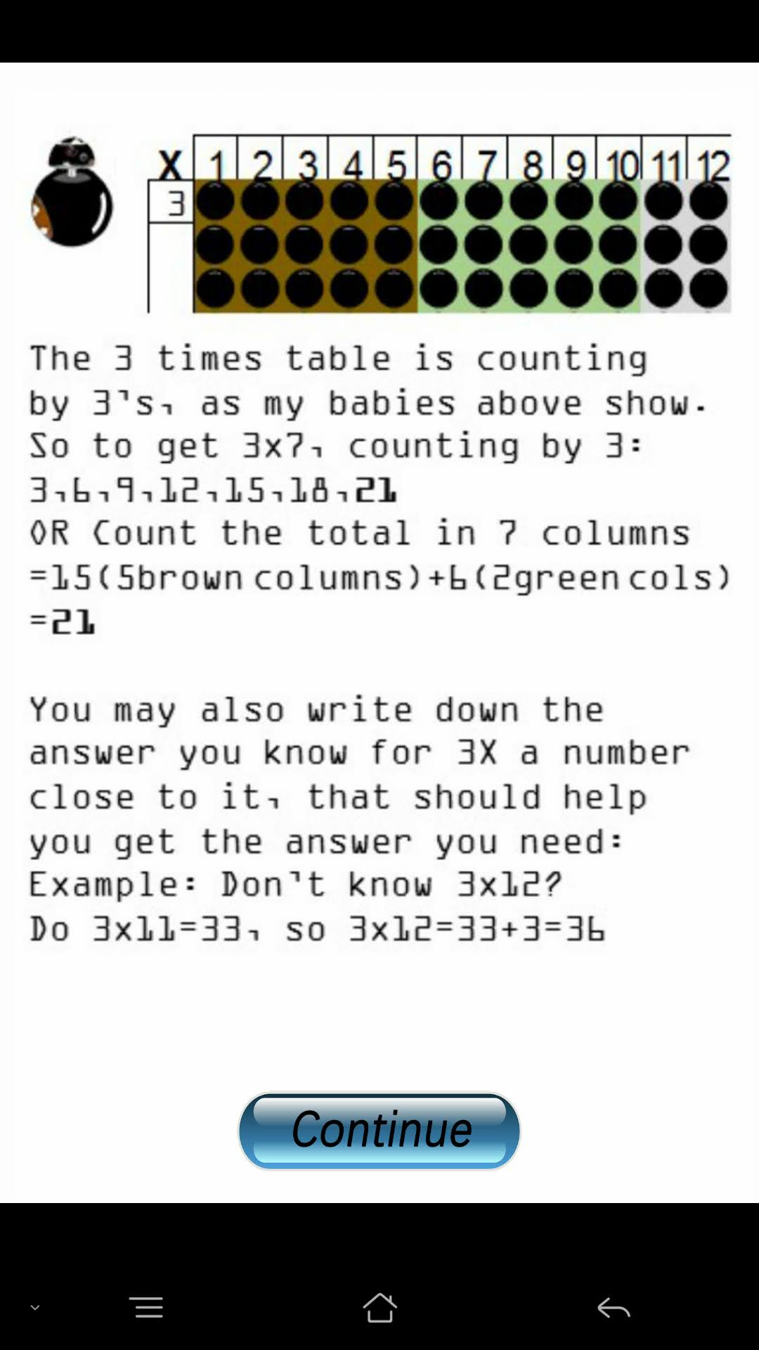

Slide 13
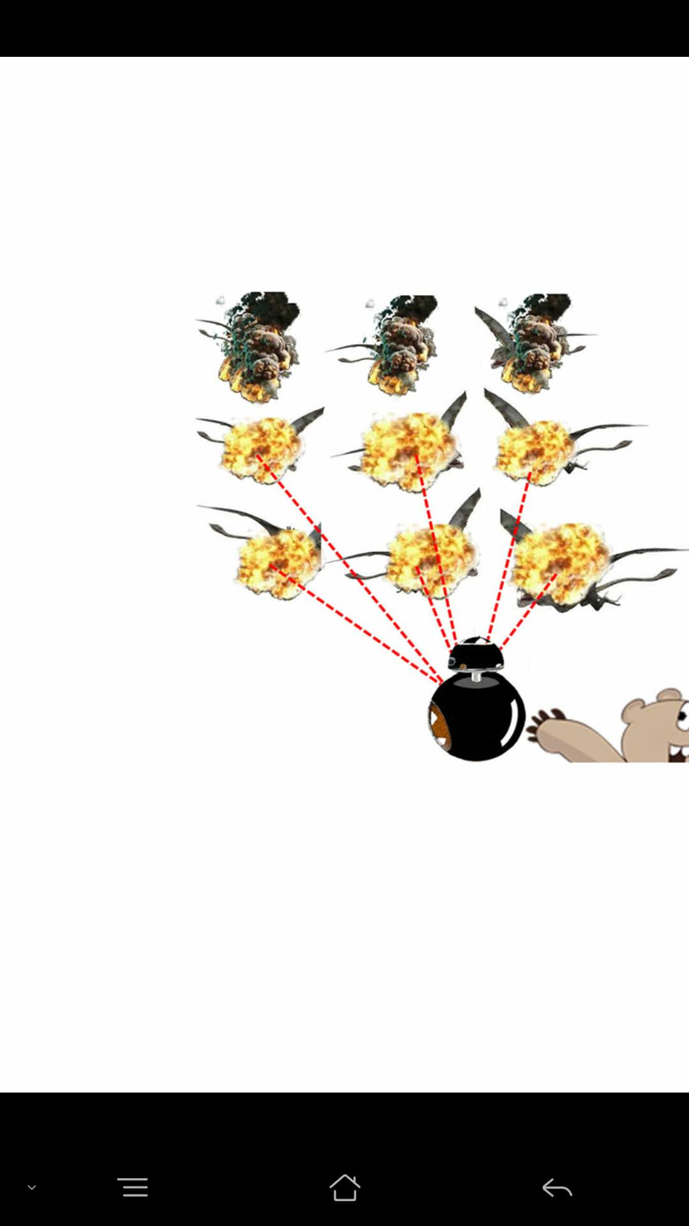
When a line of time tables is completed (either Row or
Column) correctly e.g. Player answers 3x1,3x2, 3x3,…
3x10,3x11,3x12., all twelve correctly ;
At the last (Correct) Answer for the line: Stop the clock
and music, and Show respective reward sequence.
At the end, of sequence
Return to Game, and
Start Music and resume timing.
On every reward sequence, insert a SKIP button,
So that player does not have to go through
the reward sequence, and return to the game.
I’ll look for the reward files to send you.
SKIP

Slide 14

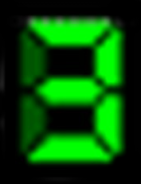

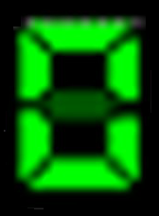
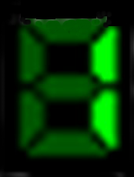


8
5
40
8
5
40
12
2
24
12
2
24
12
2
24
+
+
BONUS!
4
+
+
+4
+
+7
7
100x
n
Upon entering the correct
answer (40)
Stop the music/pause the time,
and
Show Arrow +4 (the score)…
When the answer 24 is entered, (the
score reach or exceeds 100) in this
case, 99+7
Stop the music/pause timer
Show Arrow +7 (the score in this step)
Make counter turn rapidly to 106..
Turn off Arrow +7
Show flashing BONUS! And
Arrow +100xn
where n is the score that brings
total to 100 (i.e.7)
Turn counter rapidly to add 100x7
=700, to new total of 106+700=806.
Show 806,
Turn off Arrow +100xn
And BONUS..
Turn on music/ resume timer
Do the same for Bonus 200,300,400
and 500. (examples in next 2 pages)
… then make the counter turn
rapidly to 13 (9+4 in this case).
Turn off Arrow (“+4”)
Turn on music/ resume the timer

Slide 15
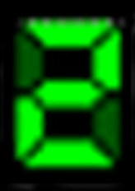
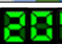


100x
8
8
64
8
8
64
8
8
64
+
+
+
BONUS!
+
BONUS!
+
+
BONUS!
+
100x
9
+9
200x
n
Same for Bonus 500 …
n = 9
204+(200x9)=204+1800
= 2004

Slide 16
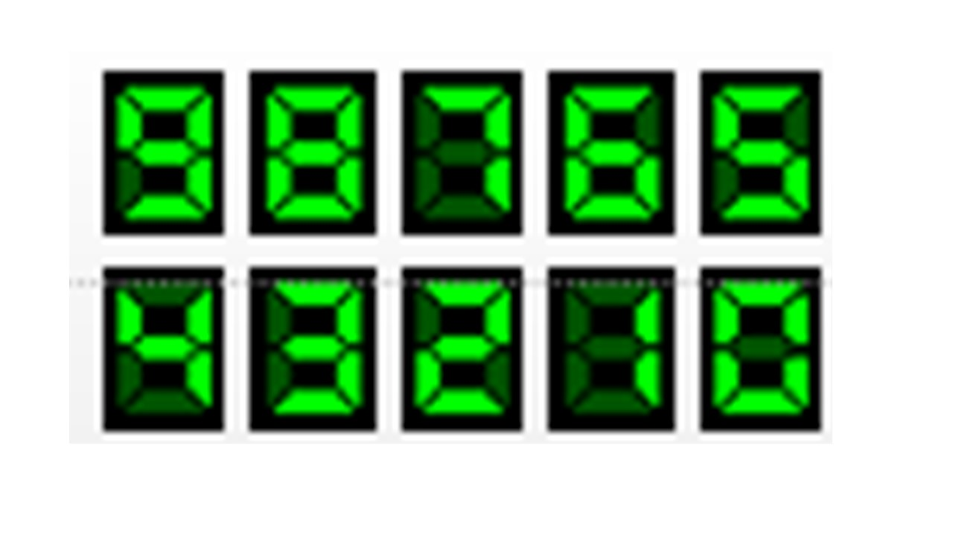
+
+
BONUS!
+
+
BONUS!
100x
11
12
132
11
12
132
11
12
132
+
+
+
BONUS!
+
BONUS!
+
BONUS!
+
+
100x
6000
+
500x
+
12
12
n
501+(500x12)=501+6000
= 6501
n = 12
in this example

